Slide 1
Subjunctive Vs. Indicative

Slide 2
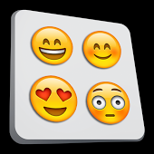
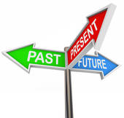
Subjunctive: Part 1
All to frequently, the topic of the subjunctive is made far more difficult than is necessary. Let’s try a slightly different approach, with the goal of making this topic less troublesome.
The subjunctive is not a tense; rather, it is a mood.
Tense refers when an action takes place.
Can you name the three tenses?
Past
Present
Future
Now can you name these three tenses in Spanish?
Pasado
Presente
Futuro

Slide 3
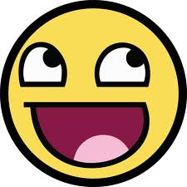
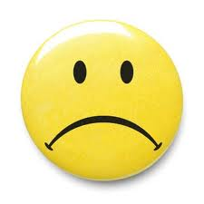
Tense vs. Mood
In English grammar, we talk about tense all the time.
It is rare to hear a grammarian talk about mood, however.
What does the word mood mean to you?
Ok, in common speech, mood is exactly that.
Our mood refers to how we are feeling.
Typical words that reflect mood might be happy, sad, scared, angry, depressed, excited, and you get the point.

Slide 4
Tense vs. Mood
When we are talking about the mood of a sentence, the meaning is a bit different.
Mood reflects how the speaker or subject feels about the action.
The subjunctive mood is rarely used in English, but it is widely used in Spanish.

Slide 5
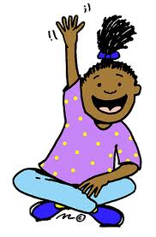
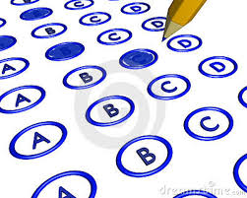
Indicative vs. Subjunctive
So far, you have studied verb tenses in the indicative mood.
What word do you see in the term indicative?
İMuy bien! And what exactly does the term indicate mean?
Yes, to indicate is to specify or show something.
For example, we might indicate the correct answer on a multiple-choice test by circling a letter.

Slide 6
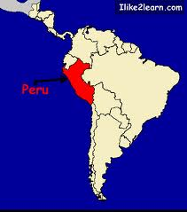
Indicative vs. Subjunctive
The indicative mood indicates factual information, certainty, and objectivity.
Can you think of an example?
Usted va a Perú en diciembre.
You are going to Peru in December.
The above sentence merely reports or indicates the fact that you are going to Peru in December, so the indicative mood is used.

Slide 7
Indicative vs. Subjunctive
How about this sentence:
El cielo es azul.
Do you think that’s indicative?
Why?
Correcto. The sky is blue is a fact.

Slide 8
Indicative vs. Subjunctive
Let’s change the above example slightly:
Yo no dudo que usted va al Perú en diciembre.
I don’t doubt that you are going to Peru in December.
What did we change about the sentence?
İExactamente! We added a clause that indicates certainty.
In the above sentence, the clause “no dudo” introduces a quality of certainty , -- the speaker has no doubt, so the indicative mood is used in the second clause (va) as well as the first (no dudo).
Note: This sentence now has two subjects. Every subjunctive sentence has two subjects.
Can you name the two subjects in the sentence?
1. Yo = I
2. Usted = you

Slide 9
Indicative vs. Subjunctive
Let’s make another slight change to our example:
Dudo que usted vaya al Perú en diciembre.
I doubt that you are going to Peru in December.
So, what did we change now?
Yes, we said I doubt instead of I don’t doubt.
Do you think this sentence is indicative?
Why or why not?
That’s right! We already said that the indicative mood indicates factual, certain information.
The minute we add doubt, the sentence can no longer be indicative.
In the above sentence, the clause “dudo” introduces a quality of uncertainty, -- the speaker does have doubt, so here the subjunctive mood is used in the second clause (vaya).
Btw, how many subjects does this sentence have?

Slide 10
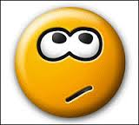
Subjunctive: Part 1
The subjunctive mood is used to express everything except certainty and objectivity: things like doubt, uncertainty, subjectivity, etc.
Yo dudo que usted vaya al Perú en diciembre.
I doubt that you are going to Peru in December.
Since the above statement does not express certainty, the subjunctive (vaya) is required in the second clause.
The difference between indicative and subjunctive is the difference between certainty/objectivity (indicative) and possibility/subjectivity (subjunctive).

Slide 11
Indicative
John goes to the store.
Is this sentence indicative or subjunctive and why?
(This sentence merely states the certain, objective fact that John goes to the store. It is indeed indicative.)
I know that John goes to the store.
(The clause “I know” tells us that the speaker feels that it is a certain, objective fact that John goes to the store.)
There is no doubt that John goes to the store.
(The clause “there is no doubt” tells us that the speaker feels that it is a certain, objective fact that John goes to the store.)

Slide 12
Subjunctive
I want John to go to the store.
(The clause “I want” tells us that the speaker feels that there is uncertainty as to whether John goes to the store.)
I hope that John goes to the store.
(The clause “I hope” tells us that the speaker feels that there is uncertainty as to whether John goes to the store.)
It is possible that John will go to the store.
(The clause “it is possible” tells us that the speaker feels that there is an uncertainty as to whether John goes to the store.)
It’s good that John goes to the store.
(The clause “it’s good” alerts us that the speaker is about to express a subjective opinion.)
It’s important that John goes to the store.
(The clause “it’s important” alerts us that the speaker is about to express a subjective opinion.)

Slide 13
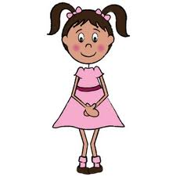
Subjunctive
Because there must be some uncertainty or subjectivity to warrant the use of the subjunctive, you will usually see it in sentences that contain a main clause which introduces a quality of uncertainty or subjectivity.
1. I hope that she will come.
What is the main or independent clause here?
I hope = independent clause
If I hope is the independent clause, what do we call that she will come?
Right, the clause is dependent because it cannot stand on its own.
2. I know that she will come.
I know = independent clause
3. I feel that she will come.
I feel = independent clause.
The above examples all have main clauses, but only the first and the third introduce an element uncertainty or subjectivity.

Slide 14
Subjunctive Recap
In learning to use the subjunctive, it is quite helpful if we can first recognize such clauses.
So far, you have studied verb tenses in the indicative mood. The indicative mood is used to express factual information, certainty, and objectivity. It merely reports the fact of what’s happening.
Usted va a Perú en diciembre.
You are going to Peru in December.
The subjunctive mood is used to express everything except certainty and objectivity: things like doubt, uncertainty, subjectivity, etc.
Yo dudo que usted vaya al Perú en diciembre.
I doubt that you are going to Peru in December.

Slide 15
Subjunctive-Subjuntivo
Indicative Certainty, objectivity, facts, reality.
Subjunctive Uncertainty, subjectivity, feelings, emotions.
Indicative
Juan va a la tienda. John goes to the store.
This sentence merely states the certain, objective fact that John goes to the store.
Yo sé que Juan va a la tienda. I know that John goes to the store.
The clause “I know” tells us that the speaker feels that it is a certain, objective fact that that John goes to the store.
No hay duda de que Juan va a la tienda. There is no doubt that John goes to the store.
The clause “there is no doubt” tells us that the speaker feels that it is a certain, objective fact that John goes to the store.

Slide 16
Subjunctive
Yo quiero que Juan vaya a la tienda.
I want John to go to the store.
The clause “I want” tells us that the speaker feels that there is uncertainty as to whether John goes to the store.
Yo espero que Juan vaya a la tienda.
I hope that John goes to the store.
The clause “I hope” tells us that the speaker feels that there is uncertainty as to whether John goes to the store.

Slide 17
Es posible que Juan vaya a la tienda.
It is possible that John will go to the store.
The clause “it is possible” tells us that the speaker feels that there is uncertainty as to whether John goes to the store.
Es bueno que Juan vaya a la tienda.
It’s good that John goes to the store.
The clause “its good” alerts us that the speaker is about to express a subjective opinion.
Es importante que Juan vaya a la tienda.
It’s important that John goes to the store.
The clause “it’s important” alerts us that the speaker is about to express a subjective opinion

Slide 18
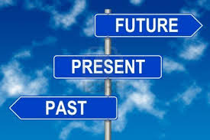
Tense vs. Mood
Can you remember the three tenses?
Past, Present, Future.
There are also three moods.
At this point, you can name two.
What are they?
Subjunctive, Indicative.
The third one is called the imperative mood.
An imperative sentence gives a command.
More on that later…

Slide 19
Tense vs. Mood
Tiempo (Tiempo de la acción.)
Modo (La actitud del sujeto.)
1. Pasado
2. Presente
3. Futuro
1. Imperativo
2. Indicativo
3. Subjuntivo

Slide 20
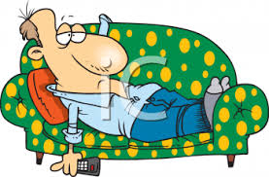
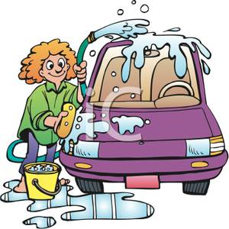
Indicative
Subjunctive
Tomás no trabaja.
Creo que es perezoso.
Sé que limpia su carro.
Objective
Facts
Certainty
Same ending
Ar Er/Ir
A E
Es importante que trabaje.
Dudo que sea trabajador.
Quiero que limpie su cuarto también.
Subjective
Doubts
Feelings
Opposite ending
Ar Er/Ir
E A

Slide 21
Subjunctive
There is a helpful acronym to help us remember when to use the subjunctive.
I’m warning you, it’s a bit strange.
Before we see the acronym, what did we already learn that every subjunctive sentence must have?
Great memory!
It must have a change in subject.
Are you ready for that strange acronym now?
Drum roll, please…

Slide 22
WEIRDO
W | (Wishes, wants) Quiero que ellos estén contentos. (S) Sé que ellos están contentos. (I)
E | (Emotions) Tengo miedo de que haya cucarachas en la cocina. (S) Sé que hay cucarachas en la cocina. (I)
I | (Impersonal Es importante que hagas la tarea. (S) Expressions) Haces la tarea todas las noches. (I)
R | (Requests, Recomiendo que John tenga su propio dormitorio. Recommendations) (S) Estoy segura que lo tiene. (I)
D | (Doubts) Dudo que venga José. (S) Creo que José sí viene. (I)
O | (Ojalá= I hope) Ojalá (que) ganemos. (S) Ganamos el partido.

Slide 23
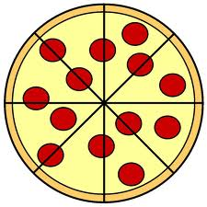
Indicative
Hablar
Comer
Hablo
Hablas
Habla
Hablamos
Hablan
Como
Comes
Come
Comemos
Comen

Slide 24
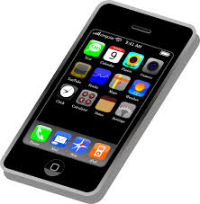
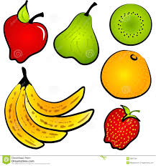
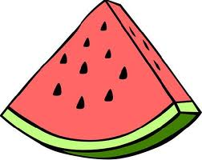
Subjunctive
Hablar
Comer
Hable
Hables
Hable
Hablemos
Hablen
Coma
Comas
Coma
Comamos
Coman

Slide 25
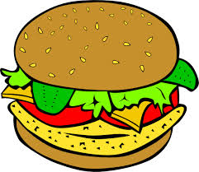
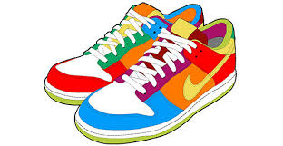
Conjugation Practice
Indicative
Subjunctive
1. Yo sé que él _____________.
Venir
Estudiar
Saber
Ver
Comer
Escuchar
Bailar
Ir
Pagar
Correr
Tener
Hablar
Decir
Mirar
1. Yo dudo que él __________.
Venir
Estudiar
Saber
Ver
Comer
Escuchar
Bailar
Ir
Pagar
Correr
Tener
Hablar
Decir
Mirar

Slide 26
İBonito Trabajo!

Slide 27
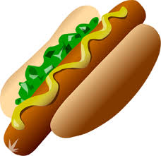
¡INTÉNTALO! ¿Subjuntivo o Indicativo? Completa estas frases con la forma correcta del verbo.
Dudo que ellos ________(trabajar).
Es cierto que él ______ (comer) mucho.
Es imposible que ellos ______ (salir).
4. Es probable que ustedes ______ (ganar).
5. No creo que ella _______ (volver).
6. Es posible que nosotros _______ (ir).
7. Dudamos que tú ________ (reciclar).
8. Creo que ellos _______ (jugar) al fútbol.
trabajen
coma
salgan
ganen
vuelva
vayamos
recicles
juegan

Slide 28
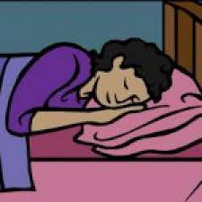
¡INTÉNTALO! Completa estas frases con la forma correcta
del verbo.
9. No niego que ustedes _______ (estudiar).
10. Es posible que ella no _______ (venir) a casa.
11. Es probable que ellos ________ (dormir).
12. Es posible que Marta _______ (llamar).
13. Tal vez Juan no nos _____ (oír).
14. No es cierto que ellos nos ________ (ayudar).
15. Es obvio que Luis _________ (aburrirse).
16. Creo que Juana _____ (ir) a casarse.
estudian
venga
duerman
llame
oiga
ayuden
se aburre
va

